Slide 1


Applying Ecosystem Accounting to Posidonia oceanica Meadows: Assessing Ecosystem Condition and Carbon Sequestration Along the Italian Coast
Umberto Grande
Parthenope, University of Naples (Italy)

Slide 2
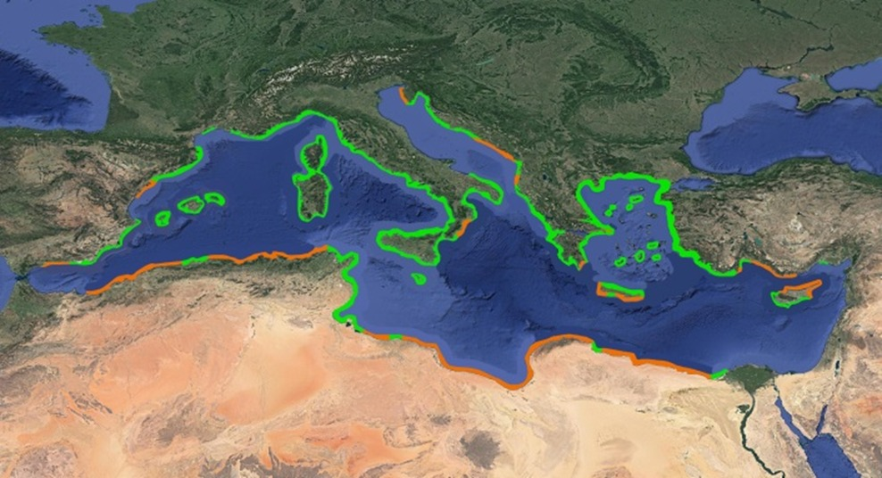
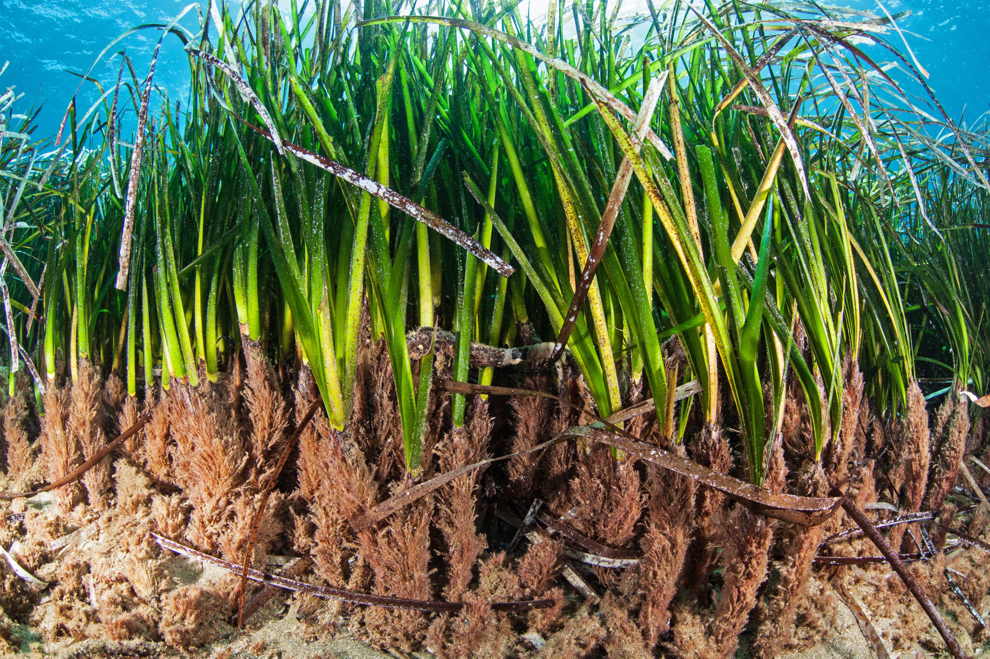
Posidonia oceanica
Map of the coast in the Mediterranean sea. The coastline with the presence of Posidonia oceanica is marked in green, and the coastline is orange, where it is presumably also found, but without sufficient data to confirm it (https://medposidonianetwork.com/distribution/).
Endemic seagrass of Mediterranean sea
High ecological and socio-economic value
Well-known as key Mediterranean Blue Carbon system

Slide 3
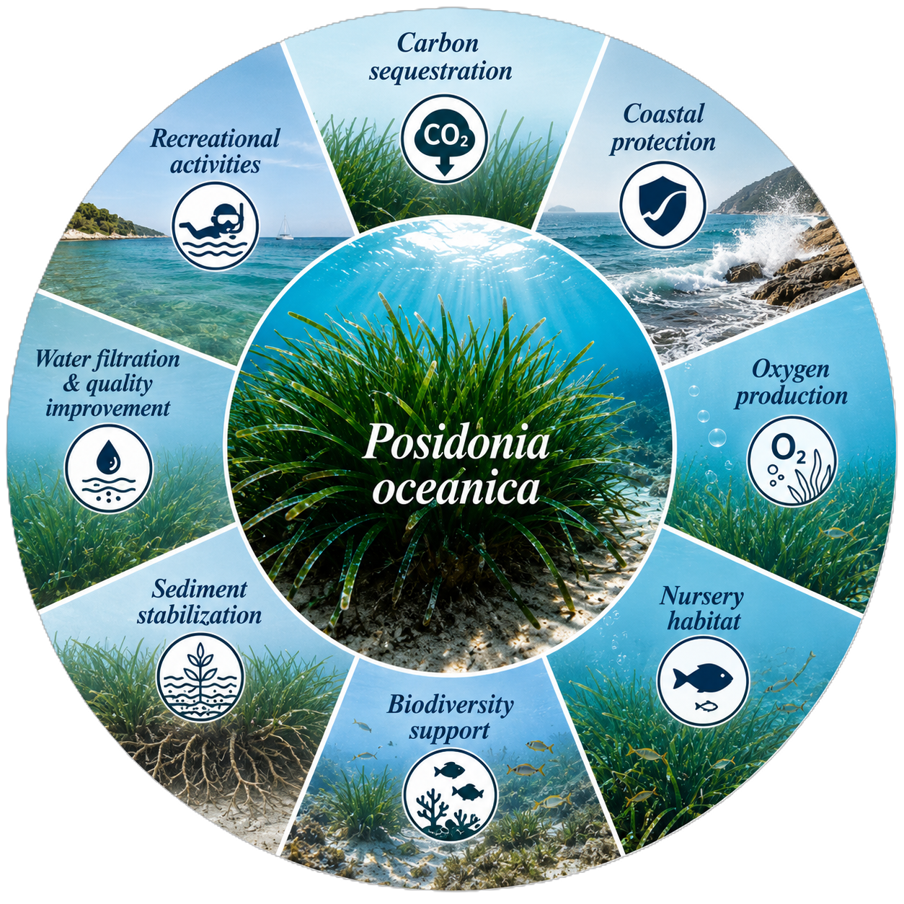
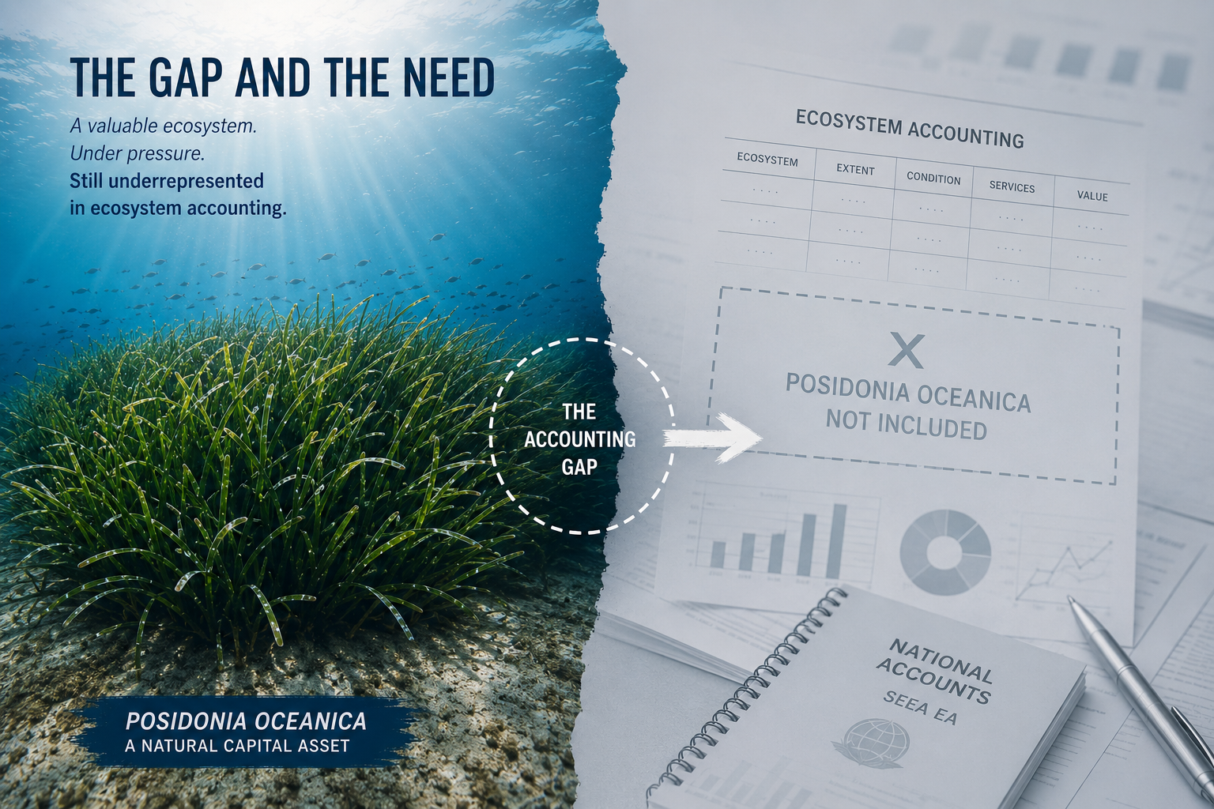
Why Posidonia oceanica matters
It provides several ecosystem services
Multiple pressures and impacts threaten its survival.
It is still underrepresented in national accounting systems
Ecoystem services provided by Posidonia oceanica.

Slide 4
Aim of the study
The main goal of this study was to propose a spatially explicit national ecosystem accounting baseline for Posidonia oceanica along the Italian coast

Slide 5
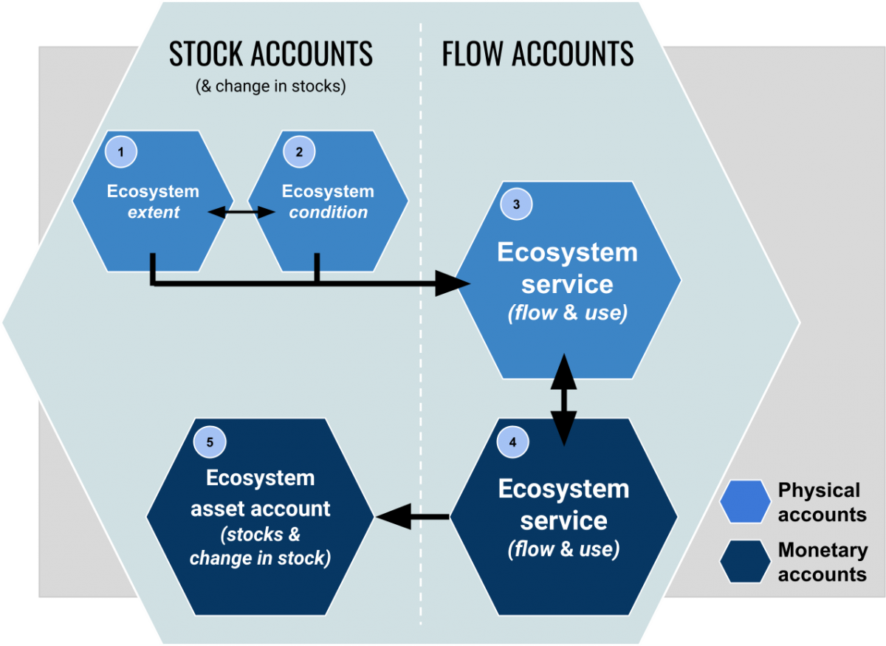
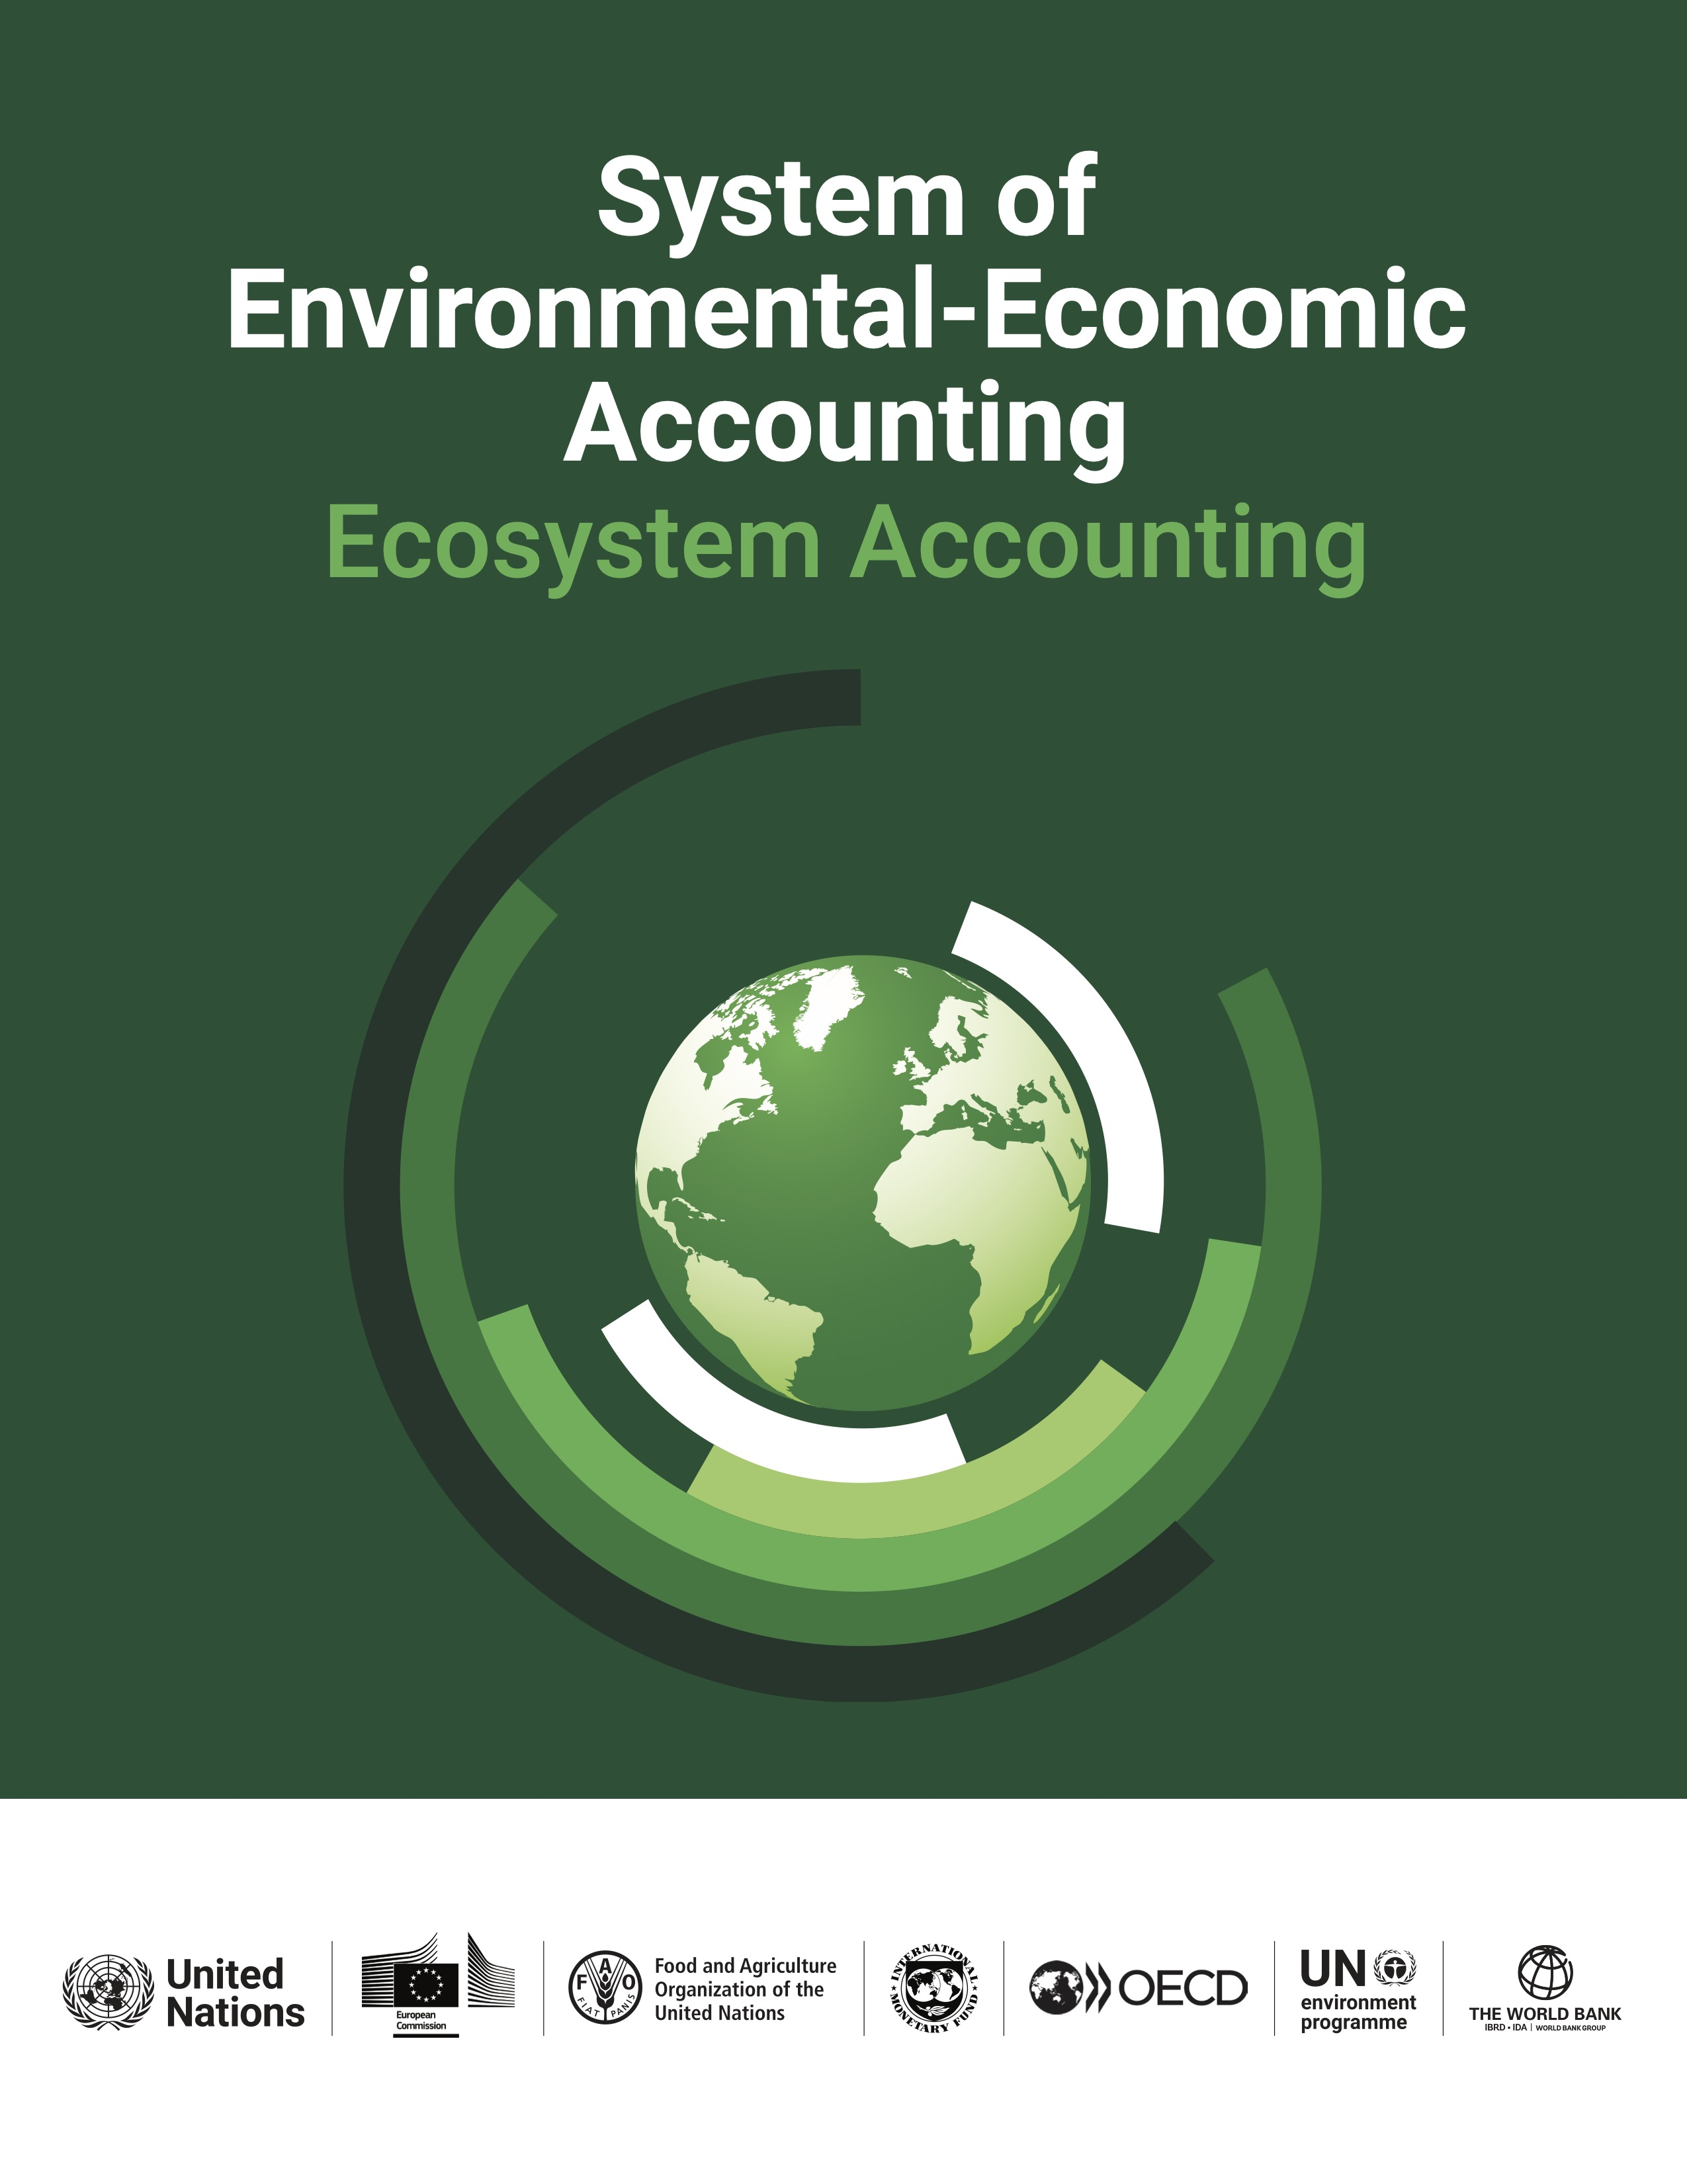
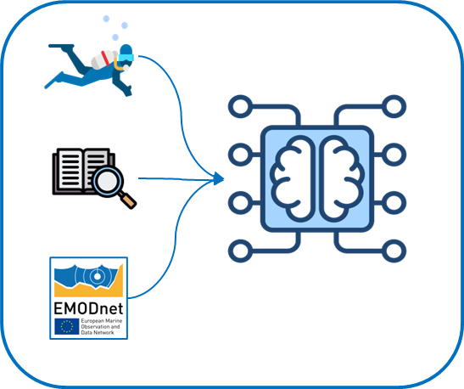
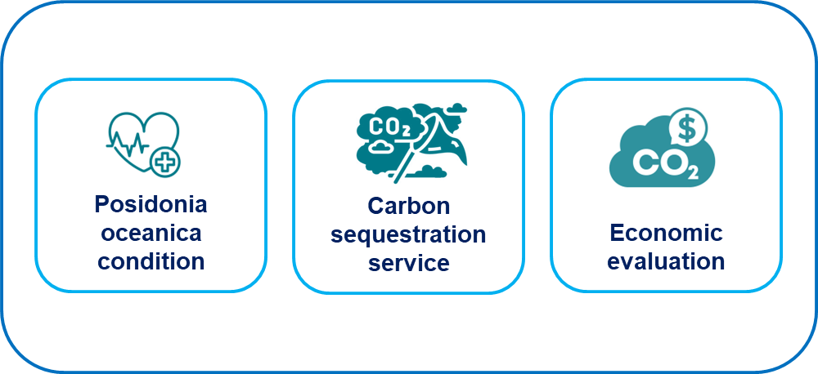
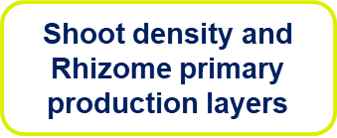
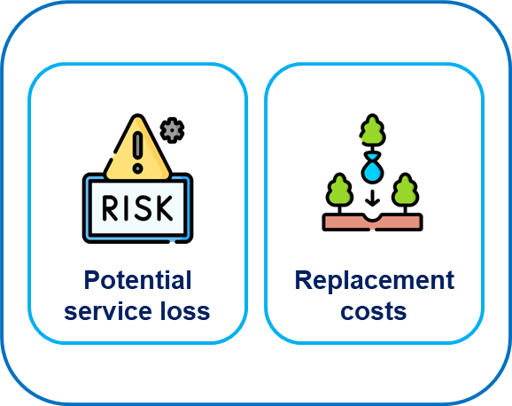

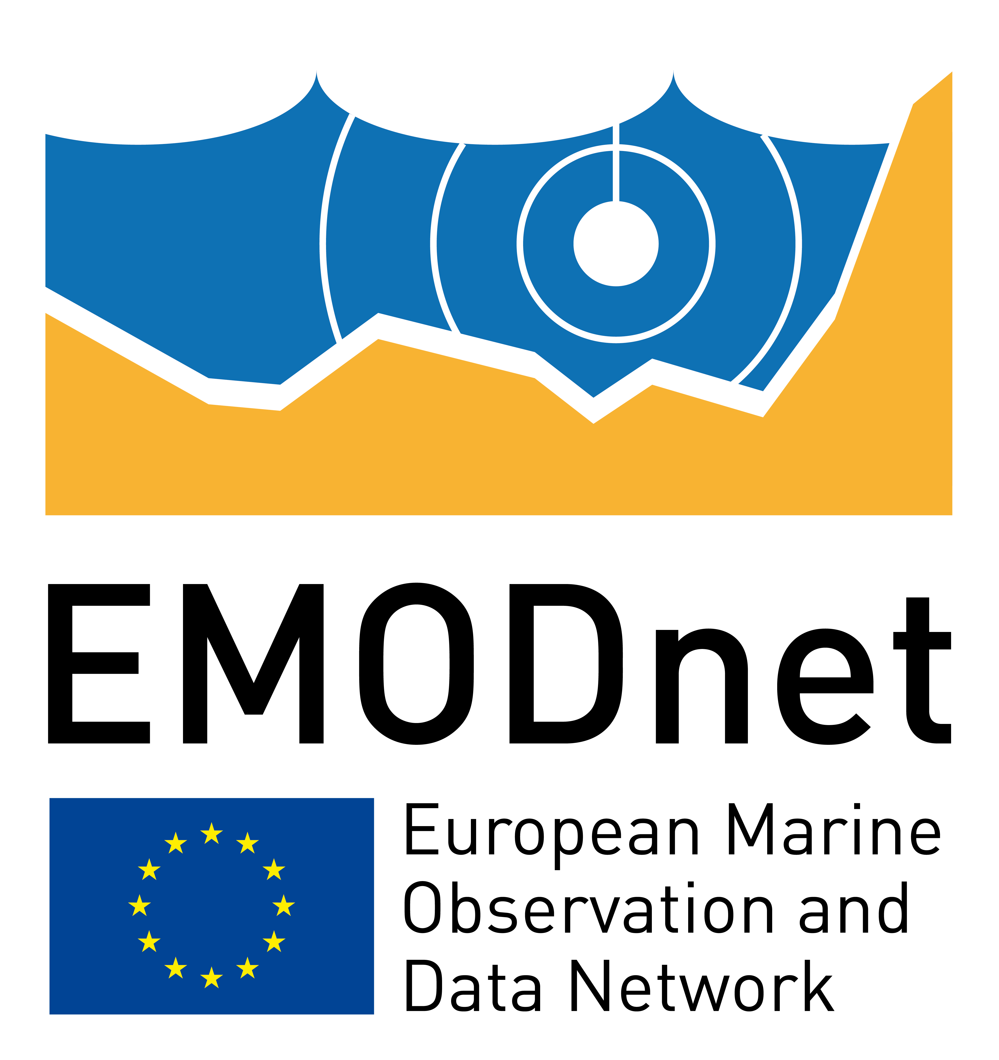
Workflow
Machine learning
Ecosystem Accounting
Priority areas

Slide 6
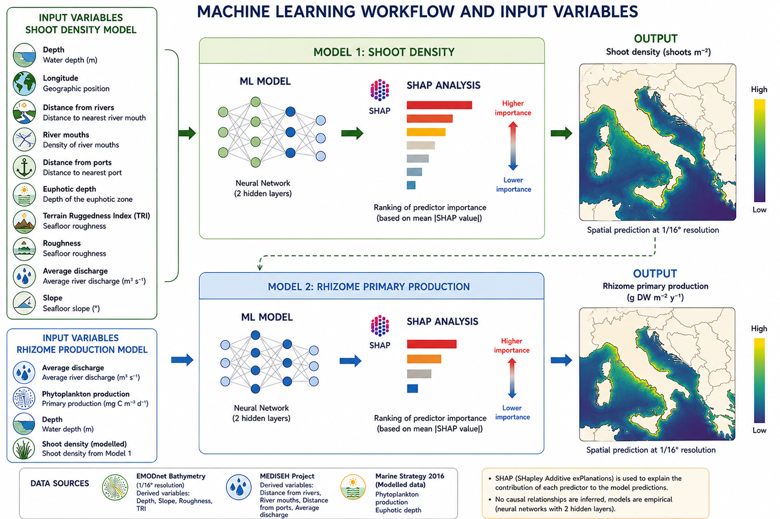
Methods: The machine learning model

Slide 7
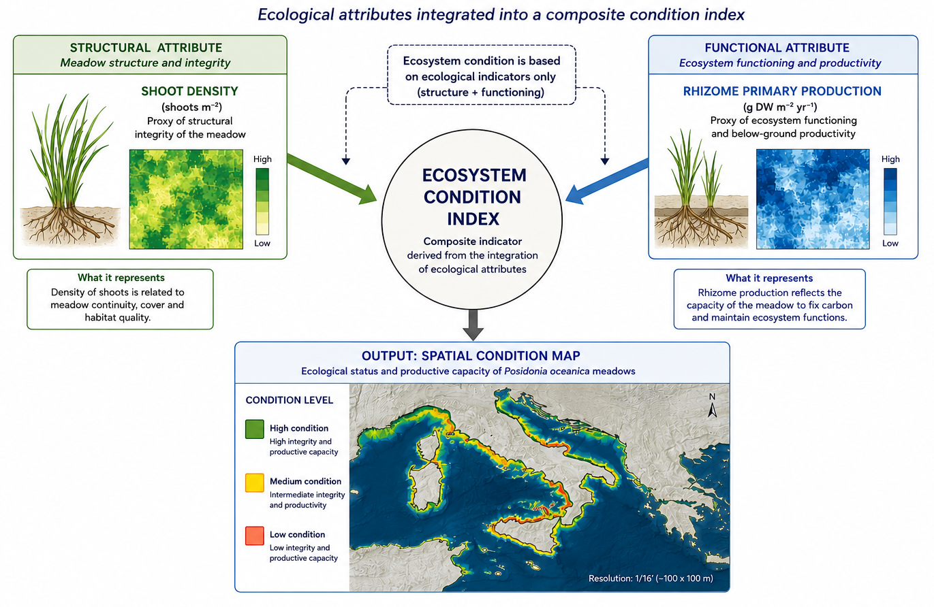
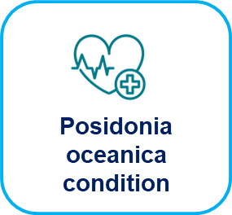
Methods: Ecosystem Condition accounting

Slide 8
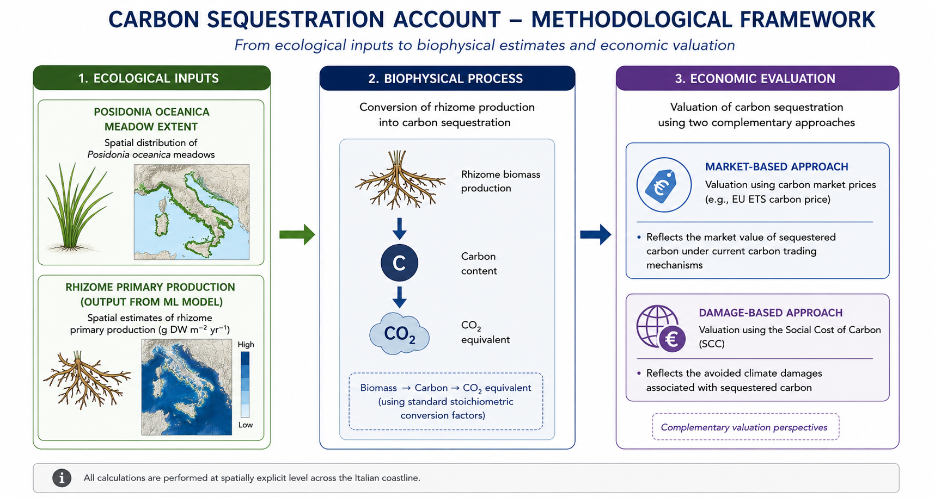
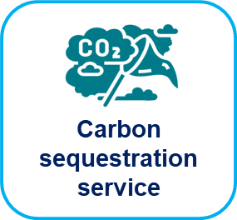
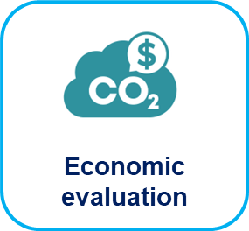
Methods: Carbon sequestration assessment

Slide 9

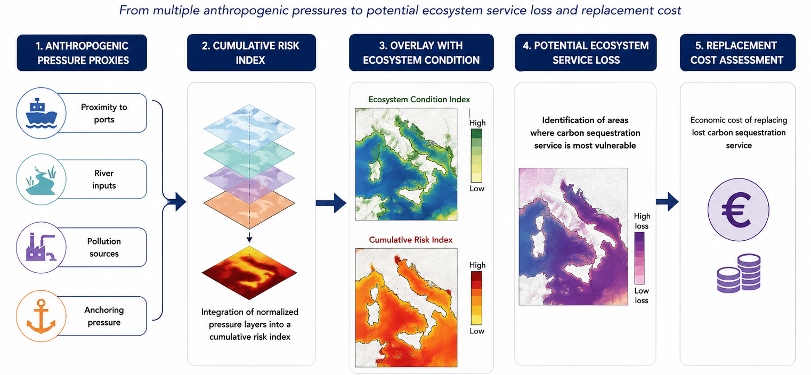

Methods: Potential service loss and replacement costs

Slide 10
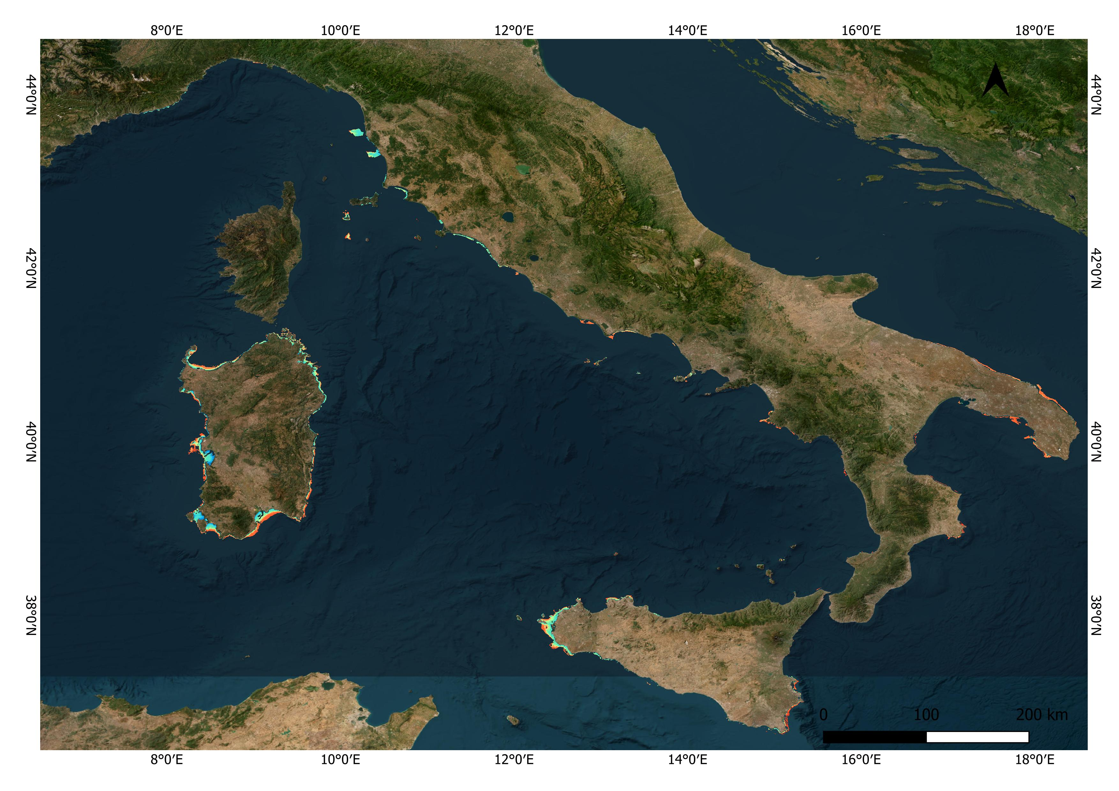
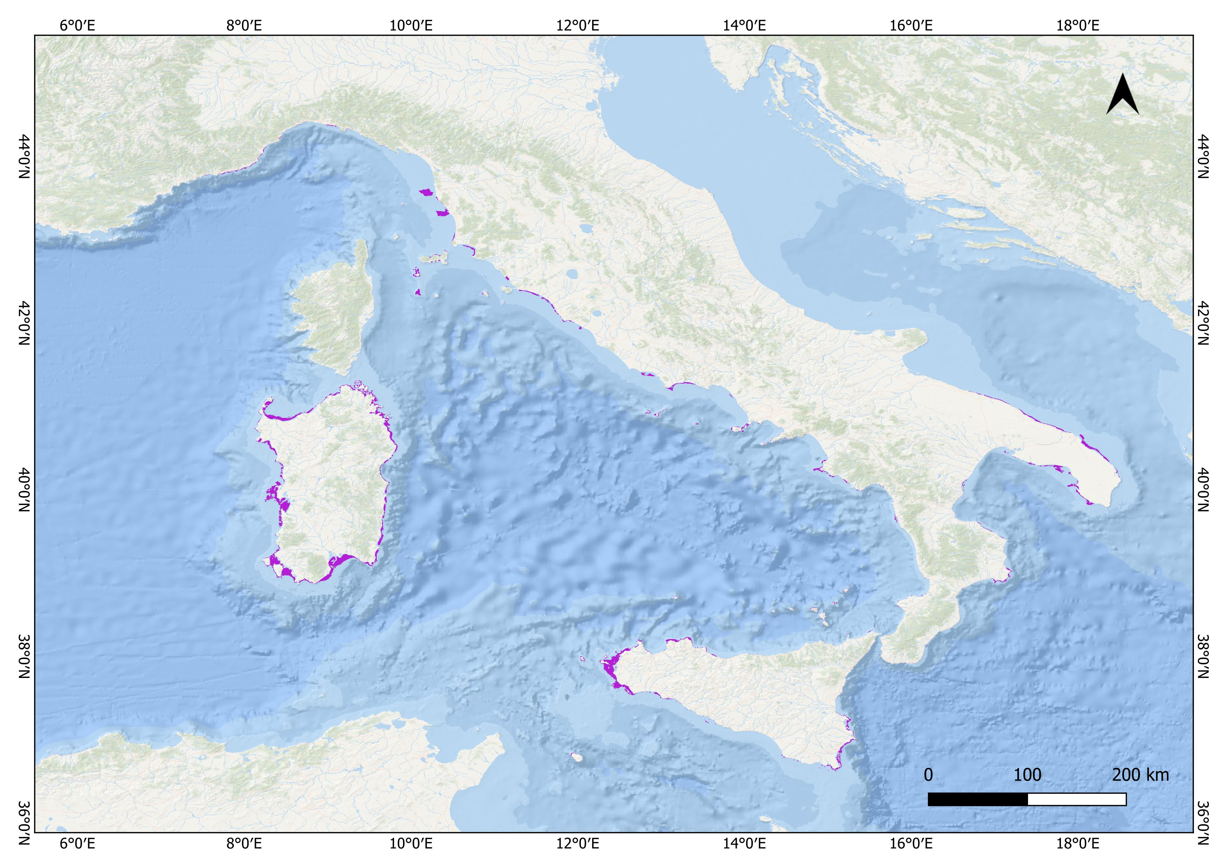
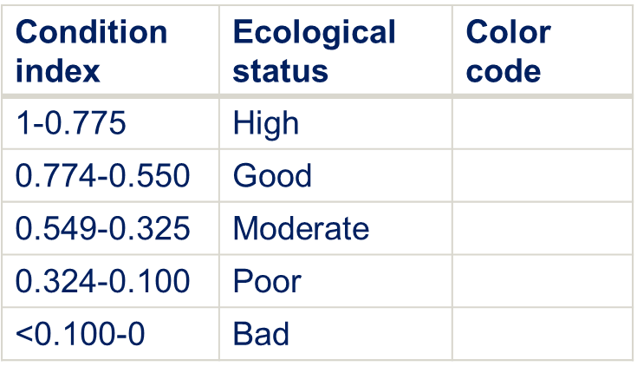
Results: Extent and potential Condition of P. oceanica meadows along the Italian coast
Ecosystem extent:
346,052 ha
Ecosystem condition:

Slide 11
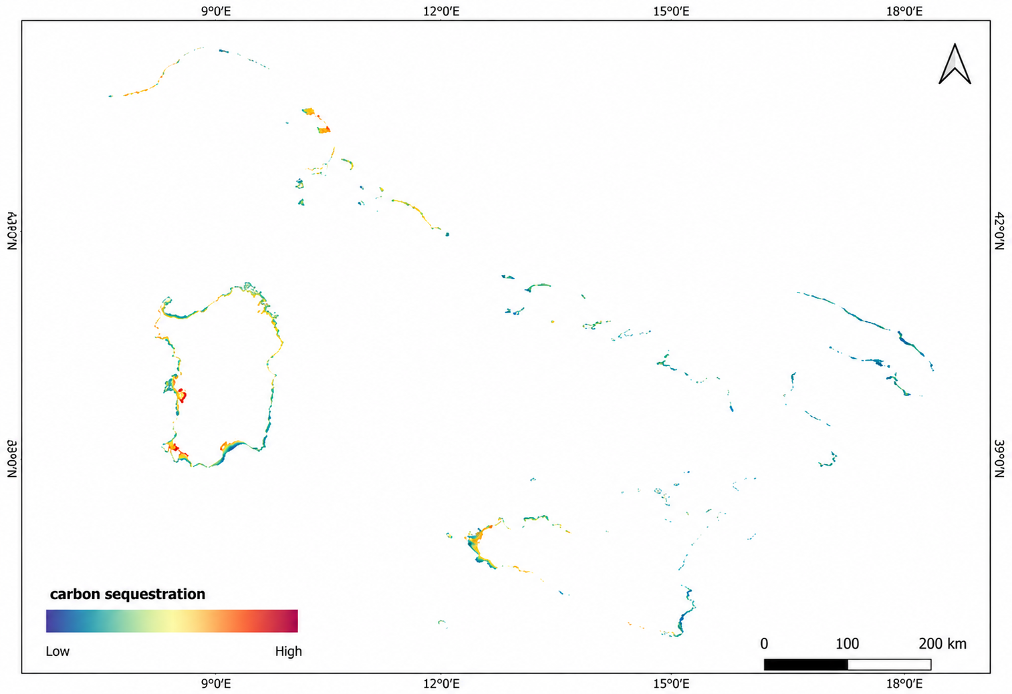
Results: Carbon sequestration at national level
Biophisical value
mean value of 50 gCm⁻²
628,254 t CO₂ yr⁻¹
Economic value
Carbon credit: 42 M€ yr⁻¹
Social Cost of Carbon: 93 M€ yr⁻¹

Slide 12
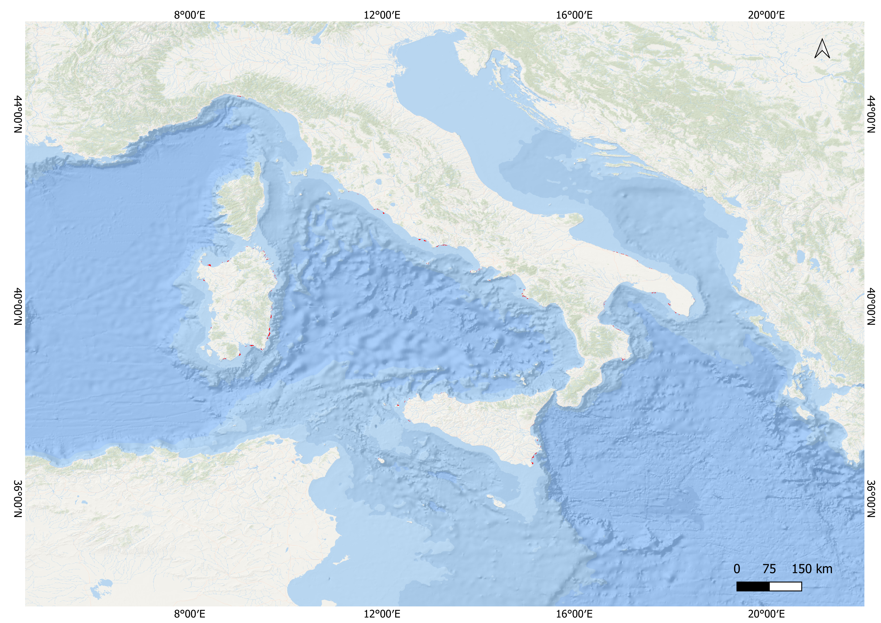
Results: Potential ecosystem loss and reforestation costs
Areas at risk:
32,500 ha
Potential carbon sequestration loss:
39,023 t CO₂ yr⁻¹
Reforestation costs:
650 billion euros
2,000 €m⁻²

Slide 13
Discussion
This study provides one of the first spatially explicit ecosystem accounting applications integrating ecosystem extent, condition, carbon sequestration, economic valuation, and risk of loss for Italian Posidonia oceanica meadows.
The machine learning model helped fill major data gaps and harmonize heterogeneous data sources at the national scale
Strong spatial heterogeneity in ecosystem condition and carbon sequestration capacity emerged along the Italian coastlines.
Posidonia oceanica meadows showed a high economic value associated with carbon sequestration services.
Priority areas and restoration costs identified in this study may support marine spatial planning and policy-making processes.
The lack of harmonized national-scale marine ecological data remains a major limitation for ecosystem accounting applications.

Slide 14
Take Home Message
Posidonia oceanica meadows confirm their strategic role as a blue carbon ecosystem in the Mediterranean Sea.
Spatial ecosystem accounting provides an operational framework to quantify ecosystem extent, condition, carbon sequestration, and associated economic values.
Integrating Posidonia oceanica into national ecosystem accounting systems could strengthen evidence-based marine conservation and restoration policies.
The SEEA-EA framework offers a powerful bridge between ecological processes, economic valuation, and environmental governance.
Spatially explicit ecosystem accounting can support marine spatial planning and climate-oriented conservation strategies.

Slide 15
Future implementation
Integration of additional anthropogenic pressure indicators to improve priority-area identification and advanced spatial hotspot analyses.
Development of risk scenarios through machine learning and spatial predictive modelling approaches.
Improvement of model robustness through uncertainty and sensitivity analyses.
Expansion of the accounting framework to include multiple ecosystem services provided by Posidonia oceanica meadows.
Validation and refinement of ecosystem extent and condition maps through upcoming national monitoring and mapping initiatives (e.g. the POSEIDON project).
Application of top-down approaches to spatially disaggregate national ecosystem accounting results at regional scale.
Implementation of the SEEA-EA ecosystem accounting tables for Posidonia oceanica ecosystems.

Slide 16
Thanks!
Umberto Grande
Parthenope, University of Naples (Italy) umberto.grande@collaboratore.uniparthenope.it

